Slide 1
Teacher Journal App

Slide 2
Project requirements: 1. Angular 8+ 2. TypeScript 3. LESS/SASS preprocessors 4. Redux *5. Lodash *6. ngx-bootstrap or angular material library *7. NodeJS *8. Database (local or remote) *9. D3 for graphics * - optional

Slide 3
Project views: 1. Students 2. Subjects 3. Statistics *4. Export * - optional

Slide 4
1. Project structure, TSLint, generate mock data. 2. Components, EventEmitters and mark up. 3. Services, Routing. 4. Pipes and DOM manipulation. 5. RxJS, HttpClient. 6. Redux. 7. Localization. 8. Custom dropdown control/picker. 9. Dynamic components. Components factory resolver. 10. Tests. *11. Optional views. *12. Optional project requirements.
Tasks:

Slide 5
Tasks estimation (without Eikon)
№ | 1 | 2 | 3 | 4 | 5 | 6 | 7 | 8 | 9 | 10 | 11* | 12*
Days | 1 | 4 | 2 | 2 | 3 | 4 | 1 | 3 | 2 | 2 | 3 | 3
Total: ~30 days

Slide 6
Workflow
Student:
Create repository on GitHub.
Provide access to GitHub repository to your mentor.
Each task - separate branch with corresponding name (task-1, task-2 …)
After the finishing task – assign and send Pull Request (PR) to your mentor.
You should briefly describe what you have done in the task in the PR.
Next task – create branch from previous branch.
(master – task-1 – task-2 – task-3 ….)
7. Correcting mistakes after mentor review – in branch you’re working now. (you’re on task-3, but after task-1 review you’ve got some mistakes to fix -
fix them in current branch, i.e. task-3)
8. You do NOT have to wait when mentor will review your PR.
Just follow the rules, do your job, correct mistakes and listen to your mentor.
Mentor:
1. Review tasks.
2. Choose your own strategy and workflow.

Slide 7
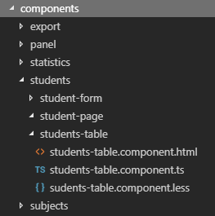
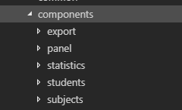
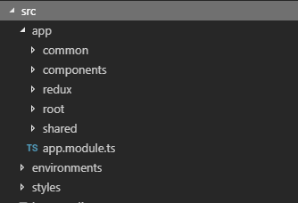
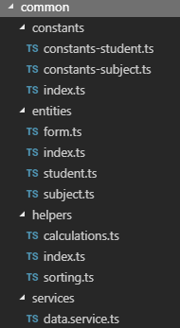
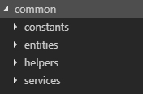
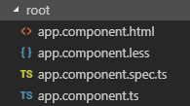
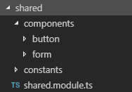


Task 1: Project structure, TSLint, generate mock data.
Project structure example:

Slide 8
For creating and manipulating mock data – use JSON Data Generator
Task 1: Project structure, TSLint, generate mock data.
Steps:
1. Generate json objects with any fields you want.
2. Download generated json file.
3. Put it in the project.
https://www.json-generator.com/

Slide 9
Task 1: Project structure, TSLint, generate mock data.
TSLint
Change project global tslint.json to tslint.json in folder “./additional-docs”

Slide 10
Task 2: Components views, Event Emiters.
YOU CAN CREATE YOUR OWN MARKUP AND STYLES, OR USE FROM EXAMPLE.
Create components views as close as possible to final views.
Add some functionality in components, test on mocked data.
Use @Input, @Output decorators.
Use *ngIf, *ngFor to iterate through mocked data in html.
Use one of the libs:
1)Ngx-bootstrap: https://valor-software.com/ngx-bootstrap 2)Angular-marerial: https://material.angular.io/

Slide 11
Task 3: Services, Routing.
Create services:
which makes “requests” for data (do not use http so far),
converters,
storage service.
Routing:
Add ability to navigate through app tabs.
Implement breadcrumbs.
Implement 404 page. Routing should redirect to 404 in case of the not matched route (404 should be user-friendly and provide the ability to back to the main page).
Implement guard for edit subject/student page (ask whether user want to save changes before he/she leaves).

Slide 12
Task 4: Pipes and DOM manipulation.
Create custom pipe (e.g. for sort).
Create a custom directive for highlighting student’s row - averageMark < 5 - blue color, averageMark >= 5 green color.
Use build-in pipes (e.g. date, uppercase, etc.).
Use Angular Renderer2 class 2-3 times in project..
Use <ng-content> 2-3 times in project.

Slide 13
Task 5: RxJS, HttpClient.
Use built-in HttpClient service.
Implement ability to add/delete student/subject/date.
Add search bar for student table and implement server side search.
Use interceptors to add headers to the requests.
Use Observables.
Wrap your mock data “request” in Observable.
Use functions: pipe, map, catchError, etc. from RxJs lib.
To mock server use json-server(example server) or any other server implementation you like

Slide 14
Task 6: Redux.
Store: https://github.com/angular-redux/store
Redux (reducers, combineReducers, etc.): https://www.npmjs.com/package/redux
OR
Use NgRx
Use effects/epics for async operations

Slide 15
Task 7: .
Add 2 locales in project: English and Russian.
Help link: https://github.com/ngx-translate/core

Slide 16
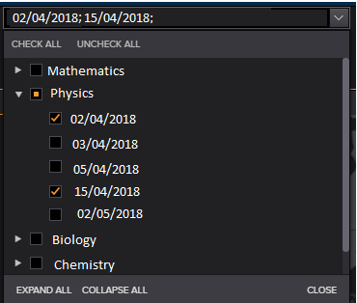
Task 8: Custom dropdown control/picker. Forms
Create separate independent component, with own service for data request.
It should looks and works like dropdown. Use ng_value_accessor.
Provide an ability to filter your data by selecting fields in dropdown.
Закрыт:
You can set your own dropdown picker view and data, but it should looks and works like dropdown.
Открыт:
Or use from Example
Example:
On Statistics view display students which fit to corresponding selected fields in dropdown.
You got list of existing subjects and by expanding each subject it shows dates when that particular subject was.
By selecting date from subject it should filter and show students which got marks in that date for that subject.
You can select multiple subjects, multiple dates.
Also provide an ability to collapse and expand, check and uncheck whole list.
* Display selected dates in the dropdown field.
* - optional

Slide 17
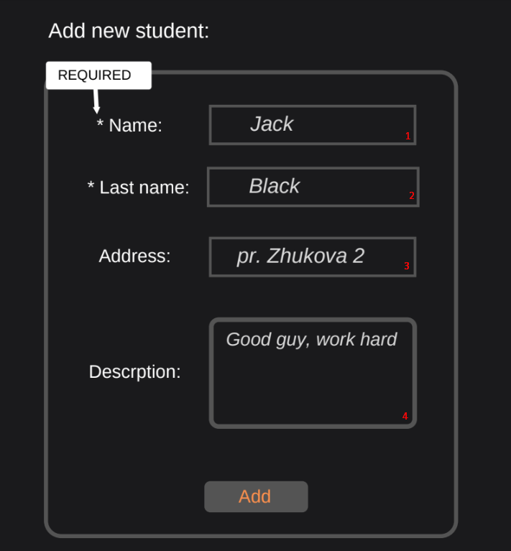
Localization
1,2 - Max length - 50 symbols, text input, numbers are not allowed
4. - Max length
Disable save button in case of any validation violation.
Errors should be displayed aside of input fields.
Apply red border to input fields in case of errors/
Do not show required field error until touched

Slide 18
Task 9: Dynamic components. Components factory resolver.
Create pop-up component.
Make it dynamic.
By getting error or success action (saving subject or student) it should shows up.
You are free with design.
Might be helpful:
https://angular.io/guide/dynamic-component-loader
https://jaxenter.com/dynamically-create-component-angular-142720.html

Slide 19
Task 10: Tests.
Provide some useful tests for 3-5 components/pipes/services.
https://angular.io/guide/testing

Slide 20
Task 11*: Optional views.
Markup the Statistics view.
Markup the Export view.
Statistics view should display:
custom dropdown from Task#8
some graphics using d3
table with filtered data
Export view for Pdf and Excel provides an ability to export:
list of students
list of subjects
*3) tables with marks
*4) whatever you want

Slide 21
Task 12*: Optional project requirements.
Connect DB, save data. It should easily installed on local machine for testing your app by mentor. Or use remote DB.
Connect NodeJS and handle all requests using it.

